Slide 1
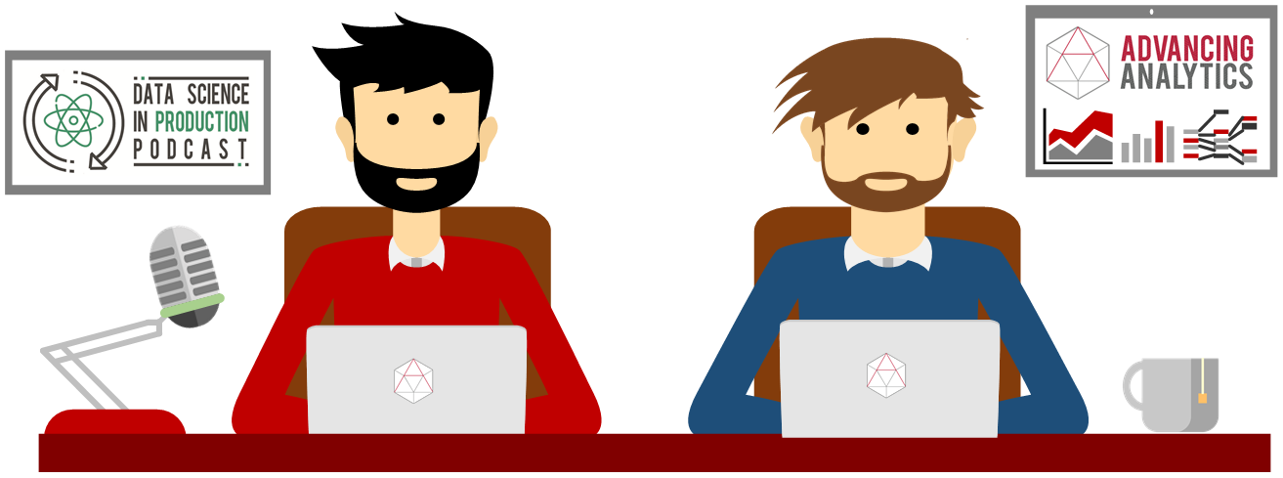
I Ain’t No Data Scientist
Why Do I Need Jupyter Notebooks?

Slide 2
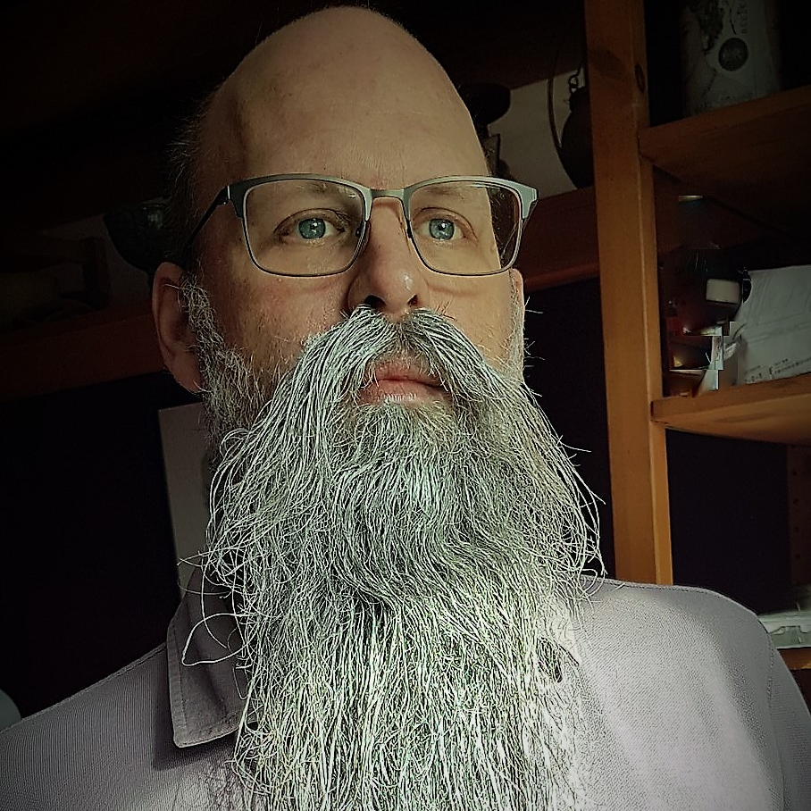
Rob Sewell
Bearded Consultant
Automator
Trainer
Dual MVP
Consultant Sewells Consulting Ltd
dbatoolsMoL dbachecks
ADSNotebooks PowerShell Community
Data Community
beard.media\book
@sqldbawithbeard
blog.robsewell.com

Slide 3
Rob Sewell
Bearded Consultant
Automator
Trainer
Dual MVP
Consultant Sewells Consulting Ltd
dbatoolsMoL dbachecks
ADSNotebooks PowerShell Community
Data Community
beard.media\book
@sqldbawithbeard
blog.robsewell.com
Notes:
OBS:SpeakerCircle

Slide 4
Rob Sewell
Bearded Consultant
Automator
Trainer
Dual MVP
Consultant Sewells Consulting Ltd
dbatoolsMoL dbachecks
ADSNotebooks PowerShell Community
Data Community
beard.media\book
@sqldbawithbeard
blog.robsewell.com
Notes:
OBS:SpeakerCircleandSide

Slide 5

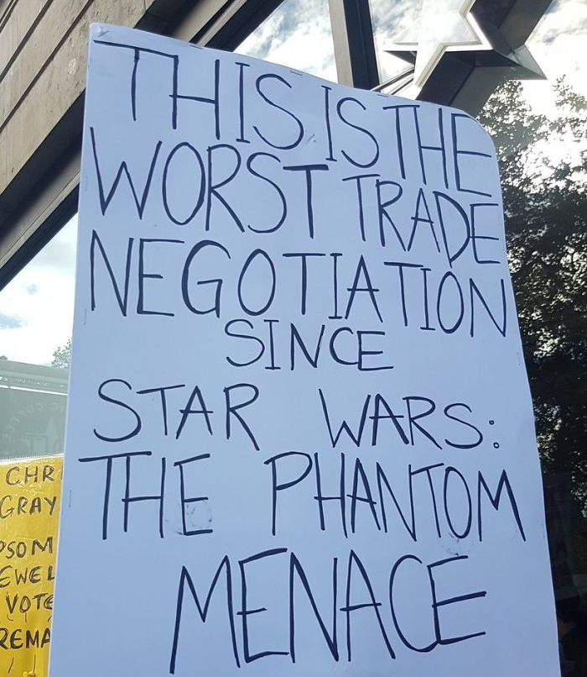
Let’s clear something up first

Slide 6
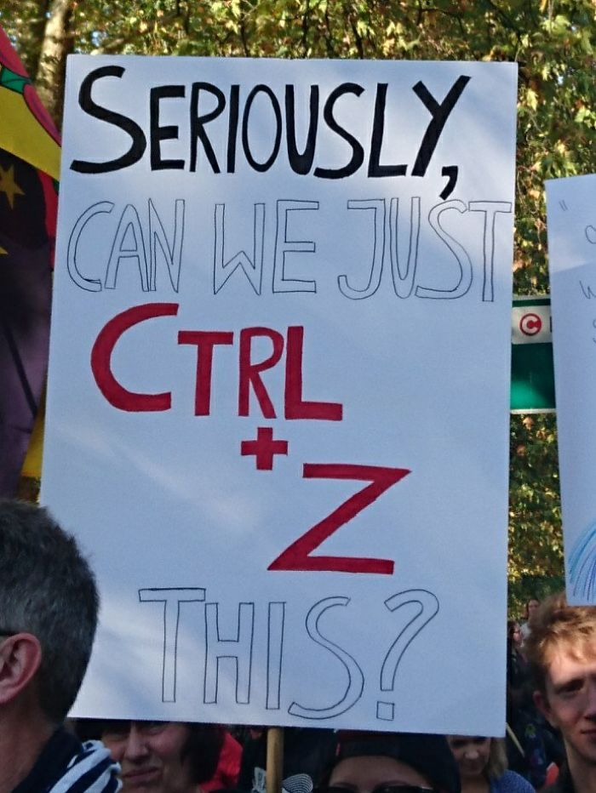

Slide 7
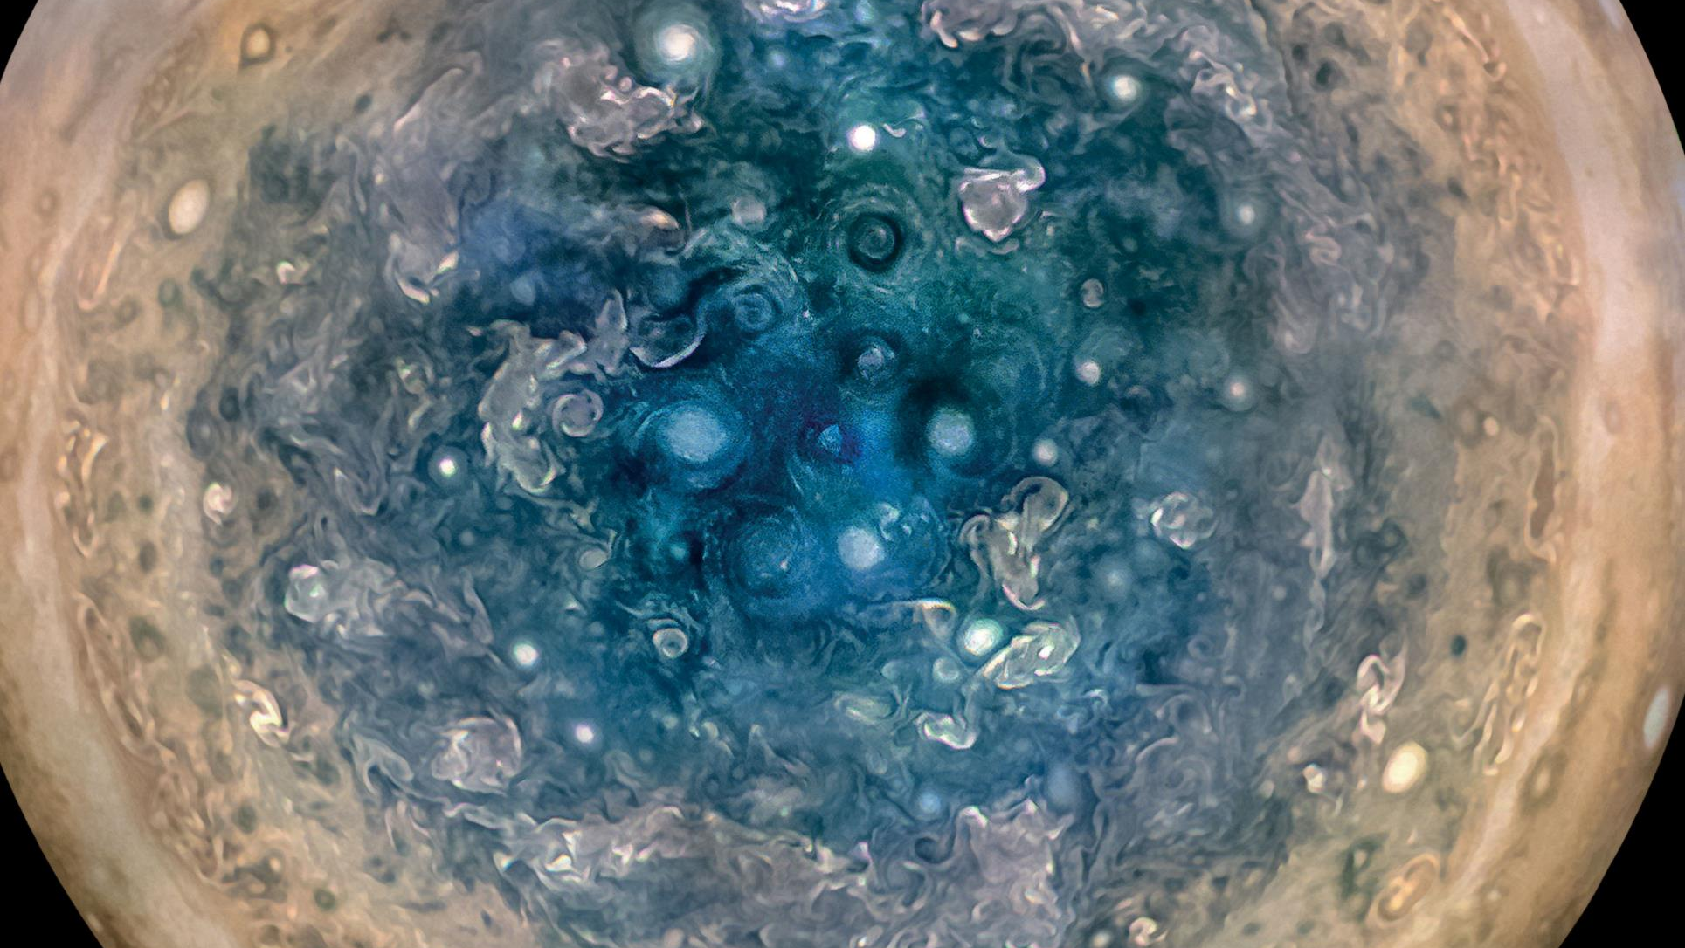

Slide 8
First, the names comes from the planet Jupiter. We wanted to pick a name that evoked the traditions and ideas of science.
Jupyter
Notes:
OBS:SpeakerTopRight

Slide 9
Jupyter
First, the names comes from the planet Jupiter. We wanted to pick a name that evoked the traditions and ideas of science.
Second, the core programming languages supported by Jupyter are Julia, Python and R. While the name Jupyter is not a direct acronym for these languages, it nods its head in those directions. In particular, the "y" in the middle of Jupyter was chosen to honor our Python heritage. See the logos of these languages in the languages folder of this repo.
https://github.com/jupyter/design/wiki/Jupyter-Logo
Notes:
OBS:SpeakerTopRight

Slide 10
Jupyter
Second, the core programming languages
supported by Jupyter are
Julia, Python and R.
While the name Jupyter is not a direct acronym for these languages, it nods its head in those directions.
In particular, the "y" in the middle of Jupyter was chosen to honor our Python heritage.
Third, Galileo was the first person to discover the moons of Jupiter. His publication on the moons of Jupiter is an early example of research that includes the underlying data in the publication. This is one of the core ideas and requirements for scientific reproducibility. Reproducibility is one of the main focuses of our project.
https://github.com/jupyter/design/wiki/Jupyter-Logo
Notes:
OBS:SpeakerTopRight

Slide 11
Jupyter
Third, Galileo was the first person to discover the moons of Jupiter. His publication on the moons of Jupiter is an early example of research that includes the underlying data in the publication.
This is one of the core ideas and requirements for scientific reproducibility. Reproducibility is one of the main focuses of our project.
https://github.com/jupyter/design/wiki/Jupyter-Logo
Notes:
OBS:SpeakerTopRight

Slide 12
So – What IS a Jupyter Notebook?
Originally for Data Scientists
Notes:
OBS:SpeakerTinySquare

Slide 13

First – Lets go back in time

Slide 14
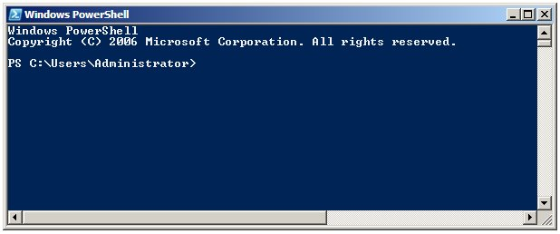
Running PowerShell
2006

Slide 15
Running PowerShell
2006

Slide 16
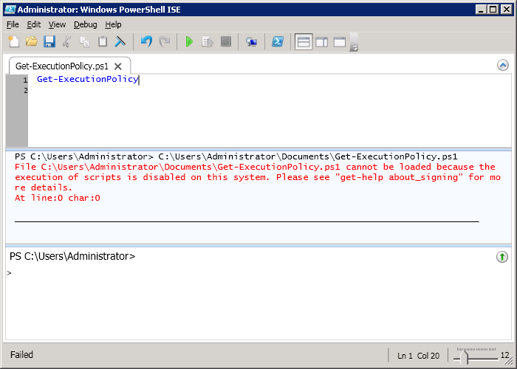
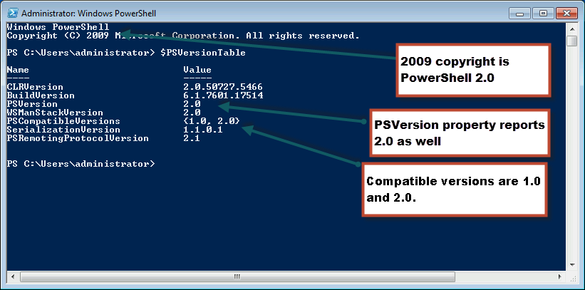
Running PowerShell
2010

Slide 17
Running PowerShell
2010

Slide 18
Running PowerShell
2010

Slide 19
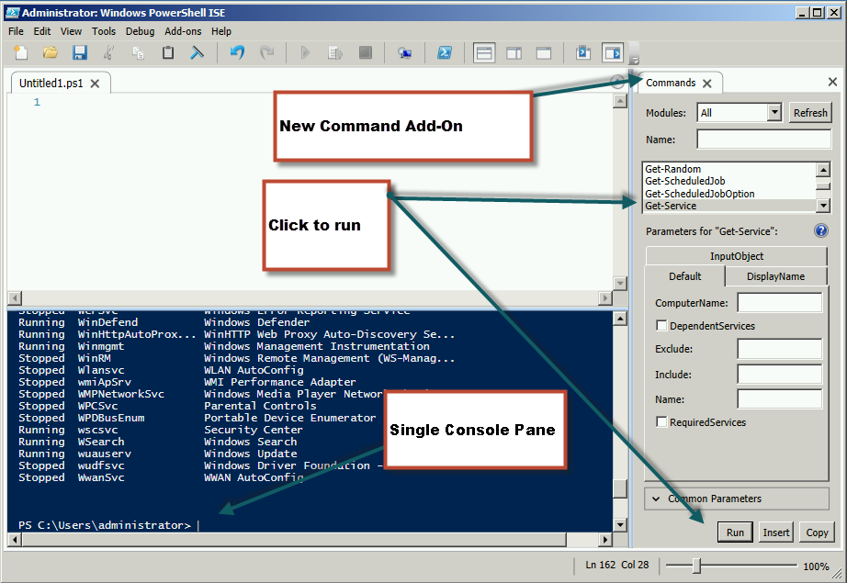
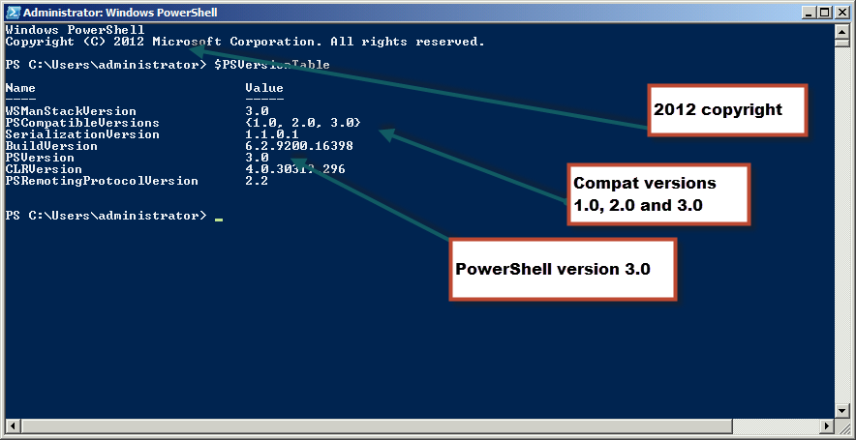
Running PowerShell
2012

Slide 20
Running PowerShell
2012

Slide 21
Running PowerShell
2012

Slide 22
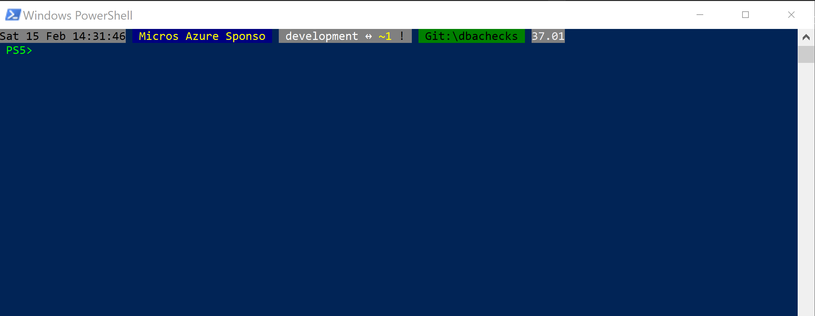
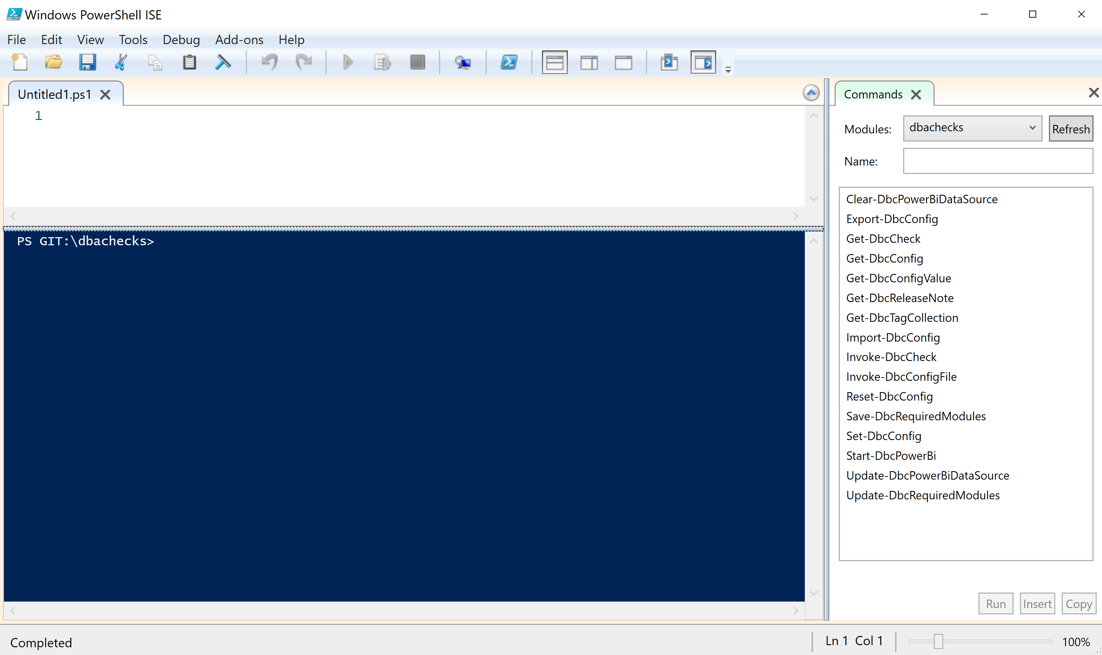
Running PowerShell
2017

Slide 23
Running PowerShell
2017

Slide 24
Running PowerShell
2017

Slide 25
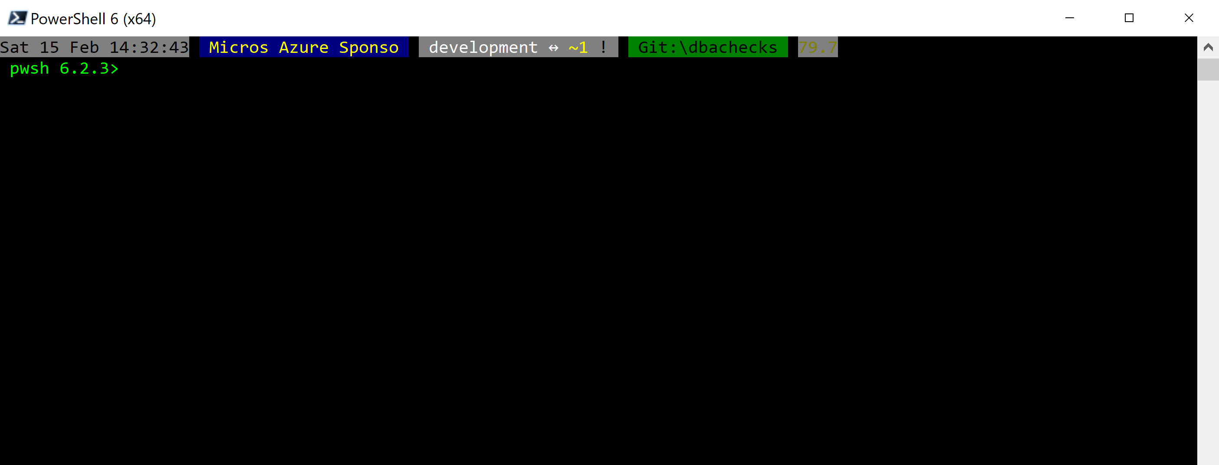
Running PowerShell
2018

Slide 26
Running PowerShell
2018

Slide 27
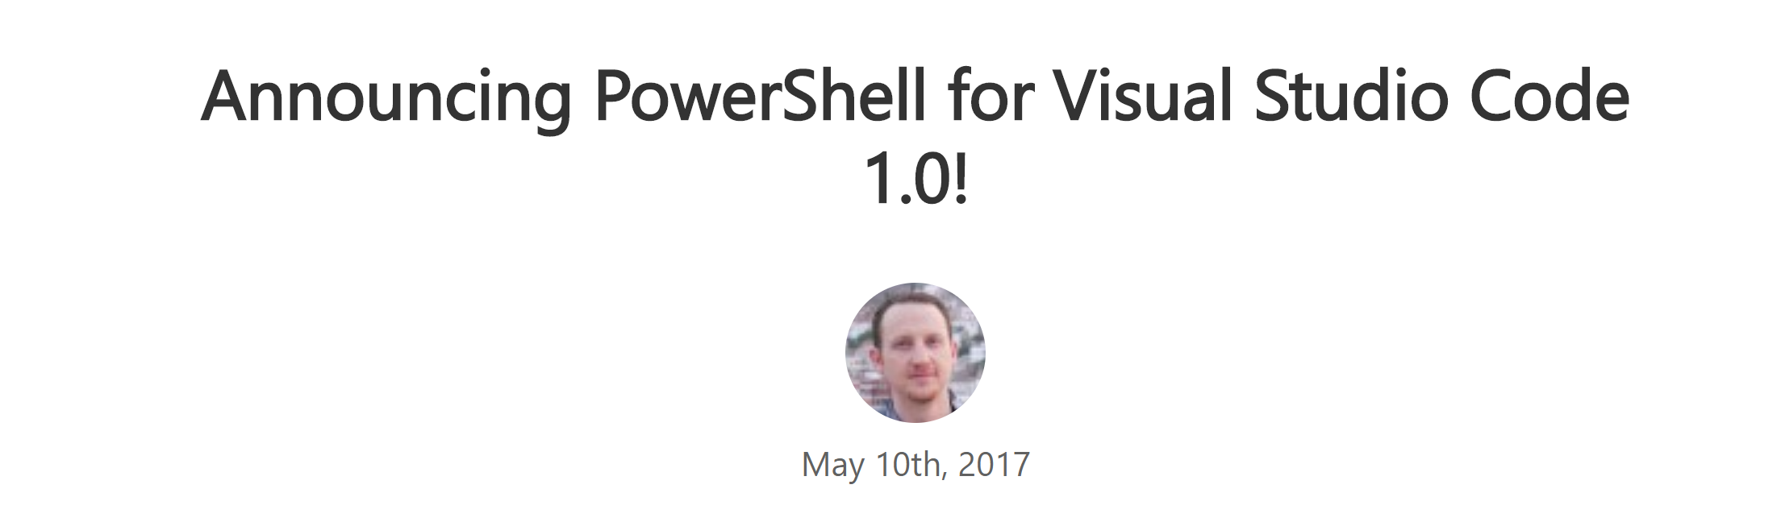
Running PowerShell
2016-17

Slide 28
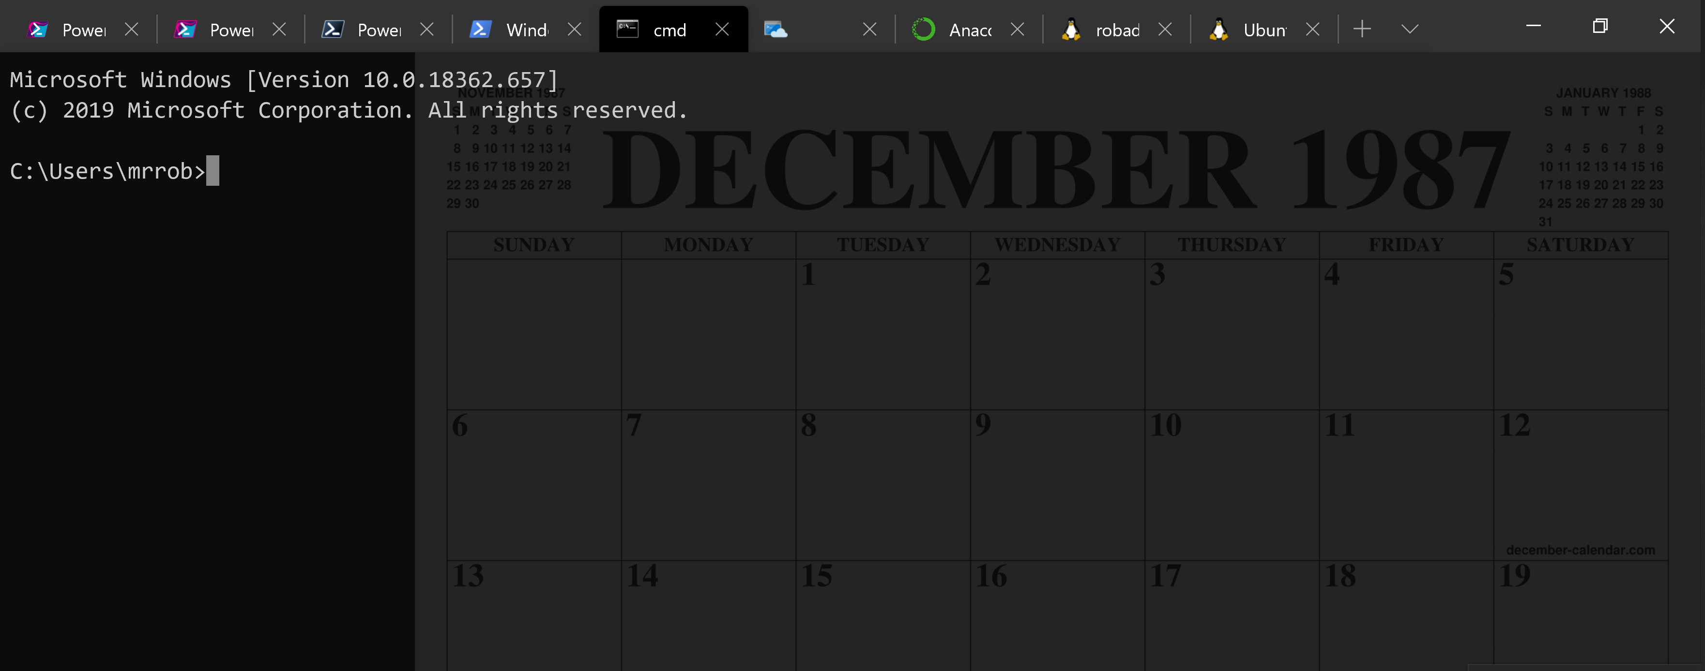
Running PowerShell
2016-17

Slide 29
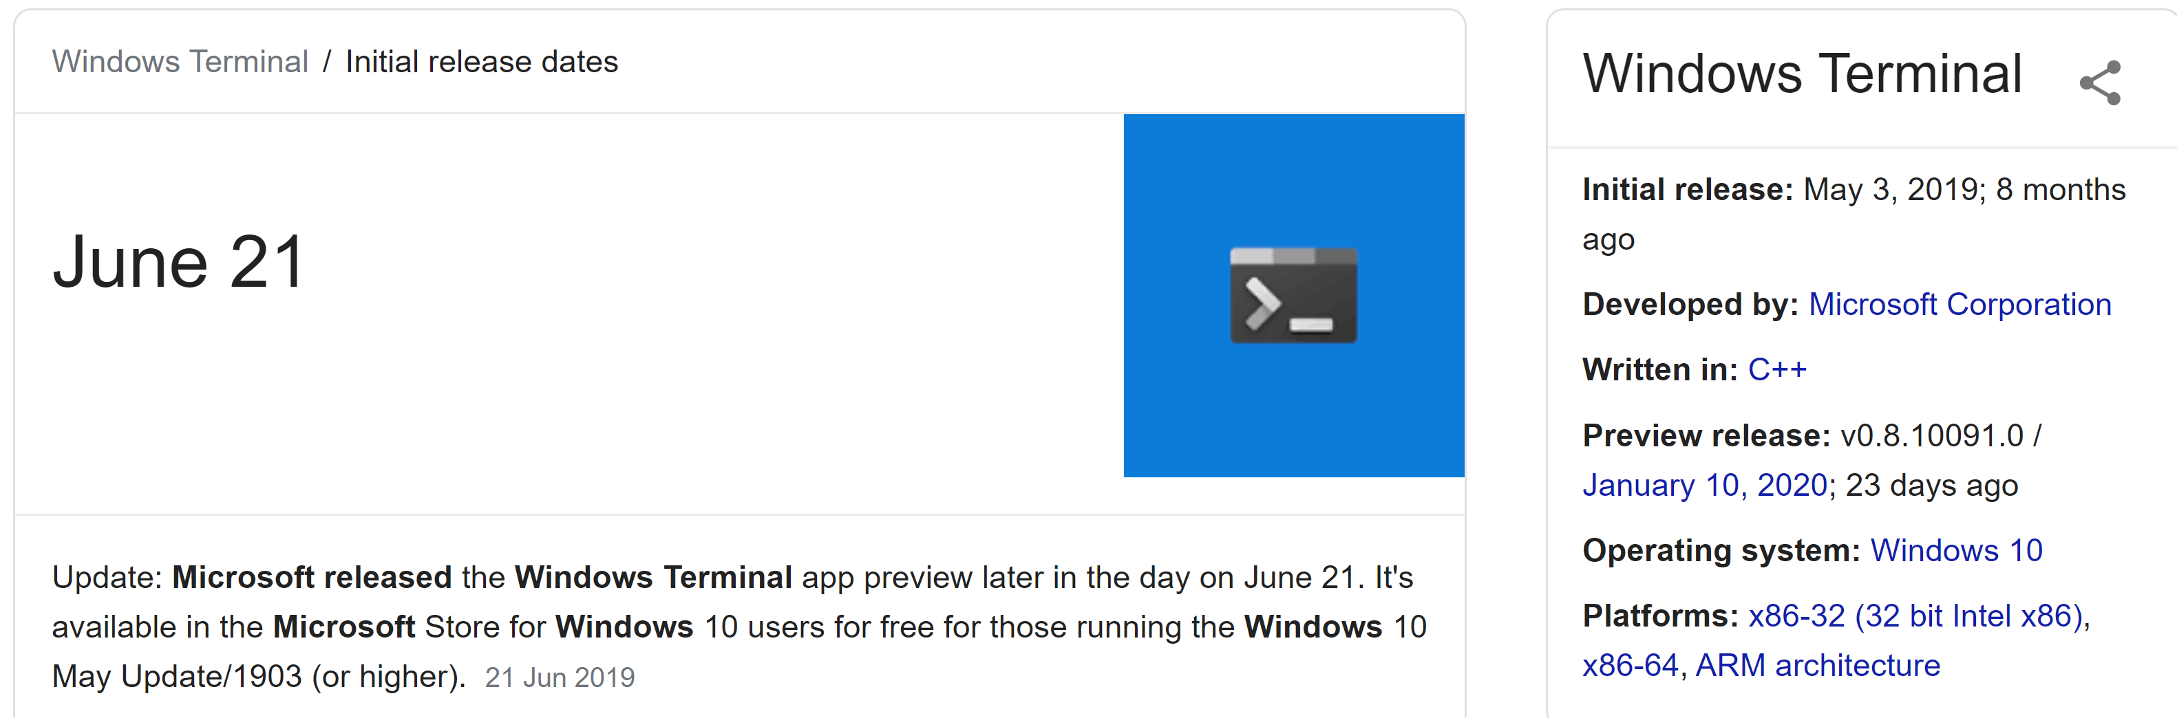
Running PowerShell
2019

Slide 30
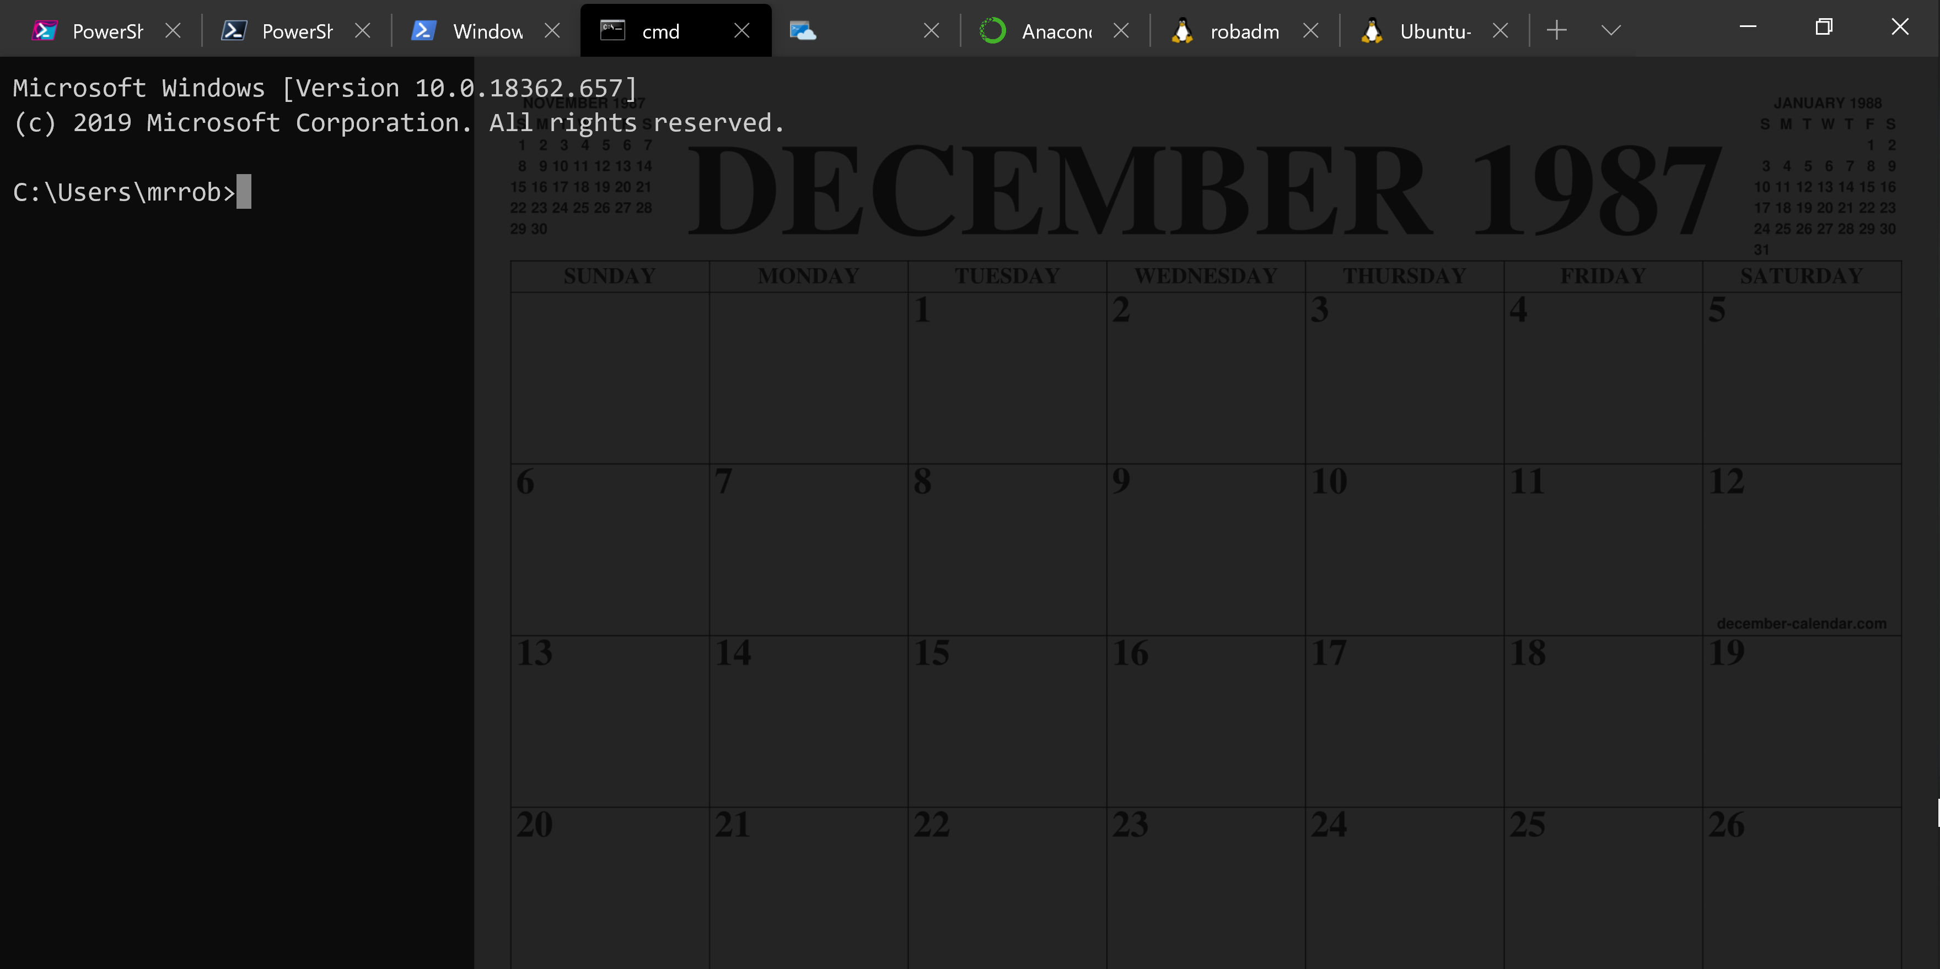
Running PowerShell
2019

Slide 31
Running PowerShell
2019

Slide 32
A Decade and a Half

Slide 33
Uh, Houston, we've had a problem
https://en.wikipedia.org/wiki/Houston,_we_have_a_problem

Slide 34
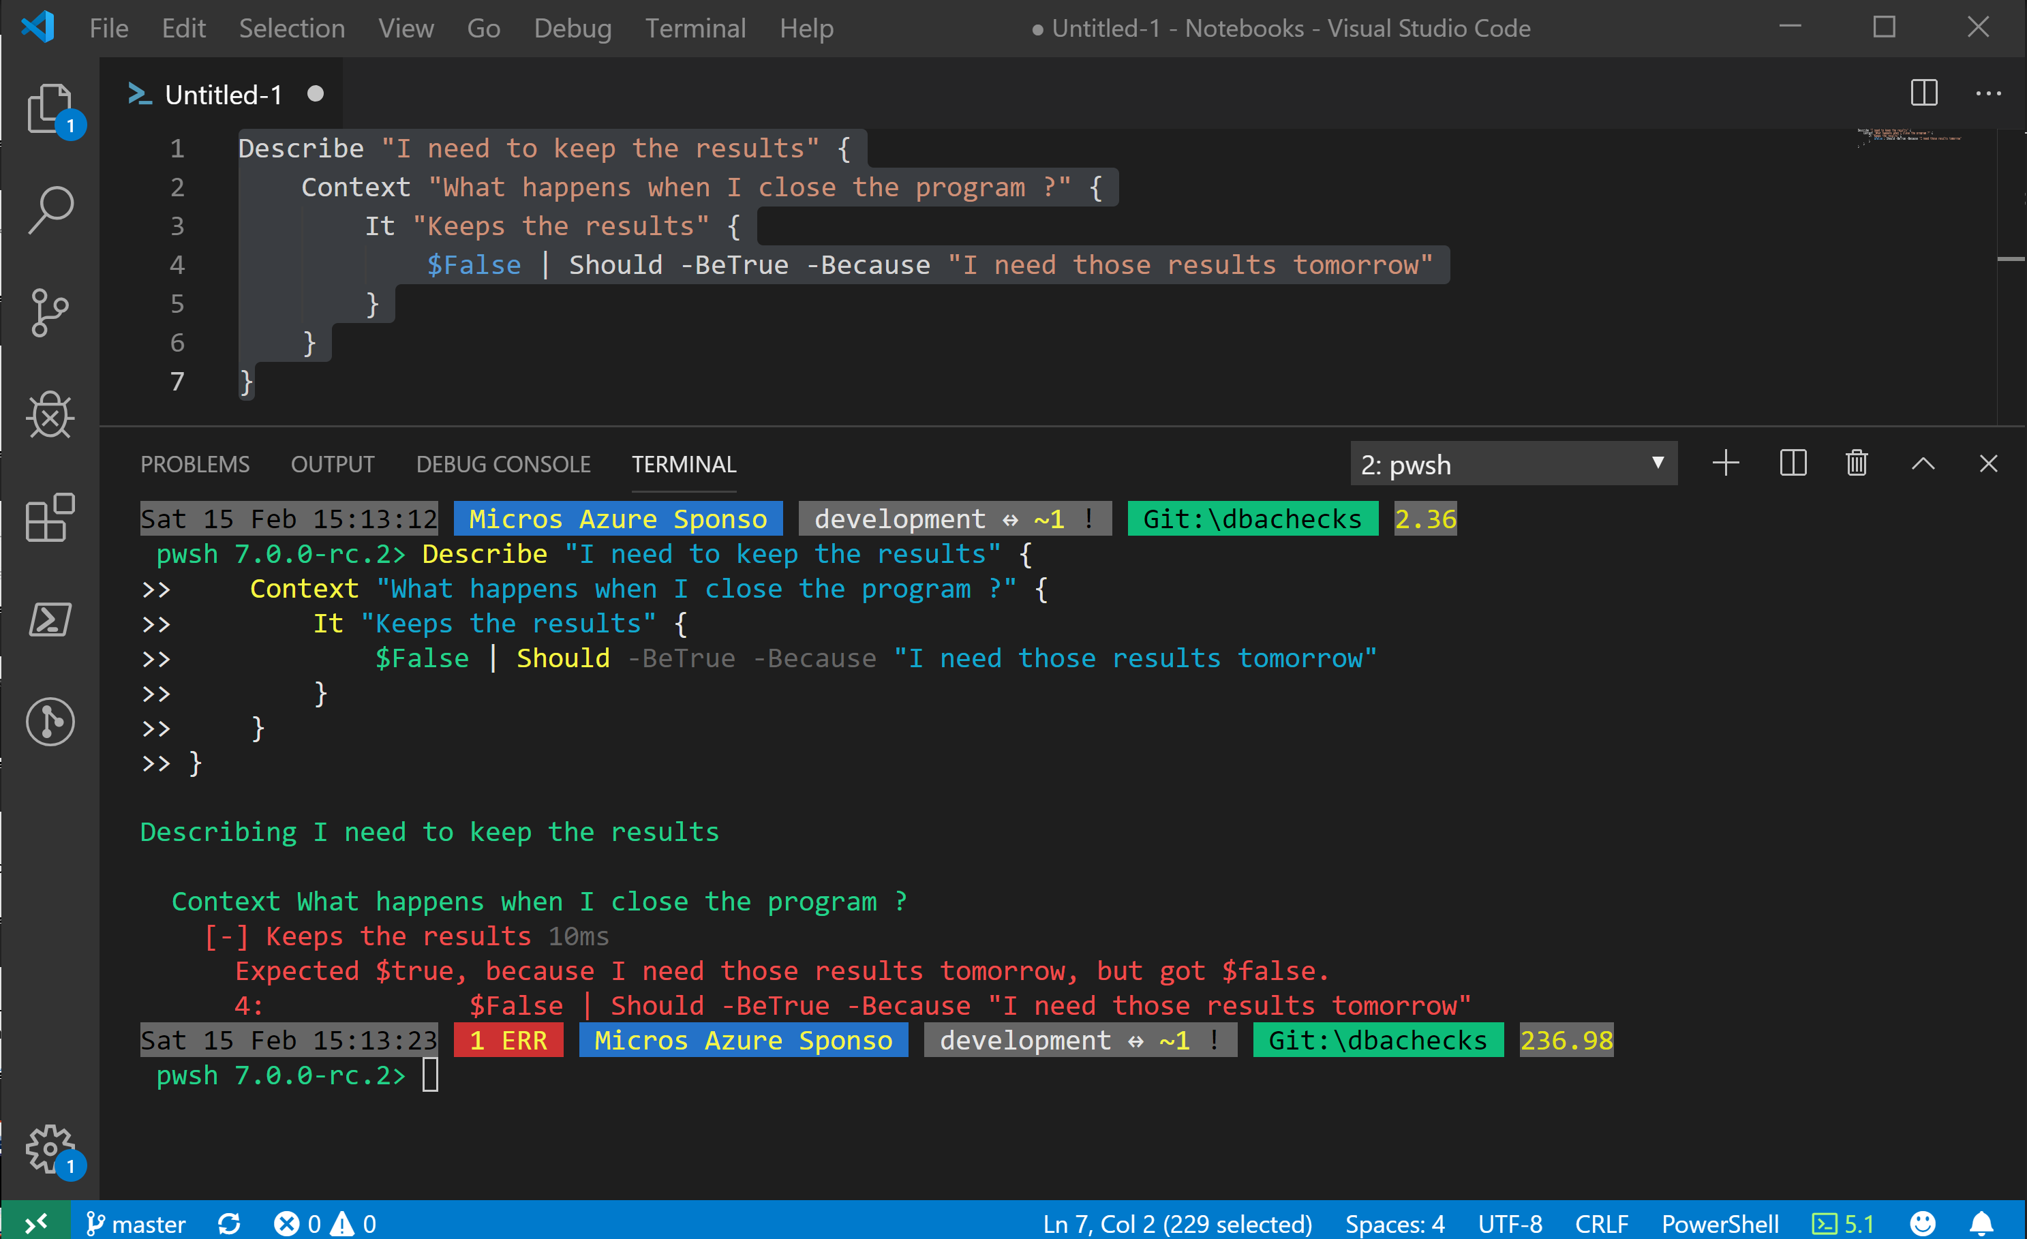
Without some effort………..

Slide 35
Without some effort………..
Notes:
OBS:SpeakerCentreBottom

Slide 36
Without some effort………..
Notes:
OBS:SpeakerCentreBottom

Slide 39
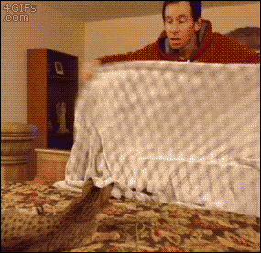

Slide 40


Slide 41
ALL
GONE

Slide 42
What is a Jupyter Notebook?
Document that can contain text, code, images and query results
Notes:
OBS:SpeakerCentreBottom

Slide 43
What is a Jupyter Notebook?
Document that can contain text, code, images and query results
Notes:
OBS:SpeakerCentreBottom

Slide 44
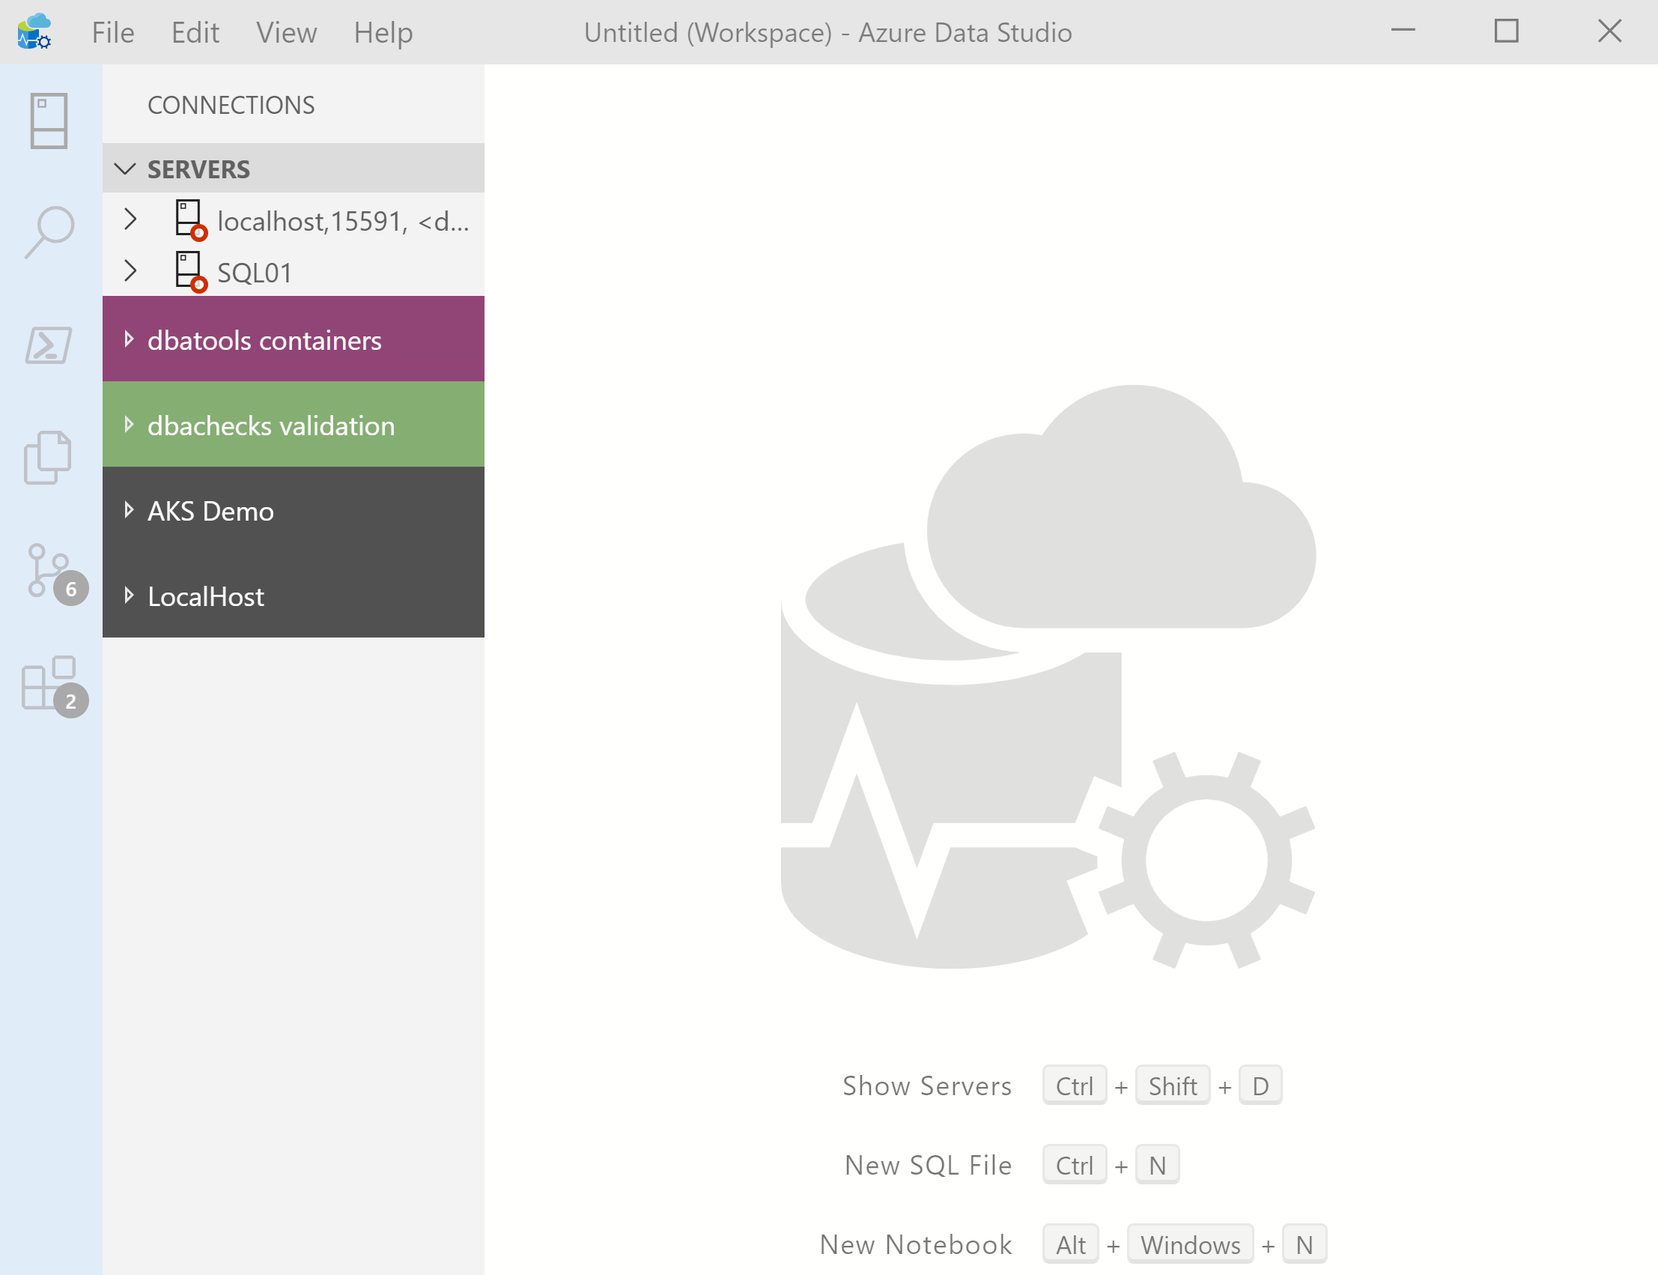
What’s Azure Data Studio ?
Cross Platform desktop environment for Data Professionals
Notes:
OBS:SpeakerCentreSquare

Slide 45
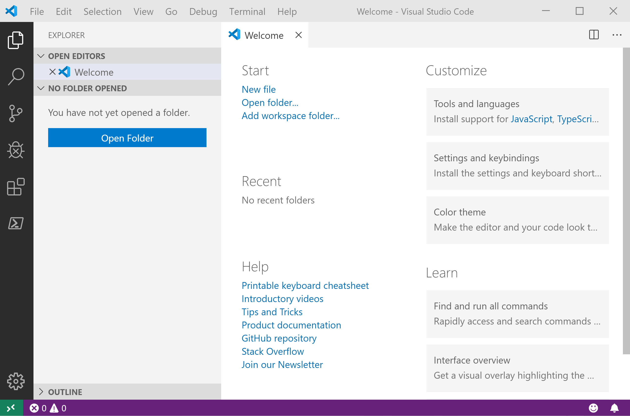
It Looks Like Visual Studio Code ?
Notes:
OBS:SpeakerCentreSquare

Slide 46
It Looks Like Visual Studio Code ?

Slide 47
.NET Interactive Notebooks
Announced at Ignite but preview announced with PowerShell February 6th 2020 https://devblogs.microsoft.com/dotnet/net-interactive-is-here-net-notebooks-preview-2/
@SQLDBAWithBeard SqlDbaWithABeard.com Rob Sewell beard.media/book

Slide 48
.NET Interactive Notebooks
All the goodness of Jupyter Notebooks with added
PowerShell (and C#) (and F#)
@SQLDBAWithBeard SqlDbaWithABeard.com Rob Sewell beard.media/book

Slide 49
Notebook Mode in the PowerShell Preview extension for Visual Studio Code
https://devblogs.microsoft.com/powershell/public-preview-of-notebook-mode-in-the-powershell-preview-extension-for-visual-studio-code/
@SQLDBAWithBeard SqlDbaWithABeard.com Rob Sewell beard.media/book

Slide 50
Whatcha gonna do?
Incident Response
Run Books – Common Tasks
Training/ New Starter Introduction
Demos – Clients/team members/boss/ presentations/open source

Slide 51

Photo by naomi tamar on Unsplash

Slide 52







Incident Response Flow & Ecosystem
From Julie @MSSQLGirl https://github.com/MsSQLGirl/jubilant-data-wizards
System Event / User Reported Incident
Use existing notebooks
Create new notebooks
Add reusable notebook
Rate existing notebooks
Log adhoc notebook in incident system
Update notebook if necessary
Automate
Incident Response System
Investigate & Mitigate
Use Notebook as the incident’s audit trail
Post Mortem
Analyze and enrich Troubleshooting Repo
Troubleshooting Notebook Repo
Notes:
JULIE

Slide 53
Enough talk
Lets see it!
beard.media\book
@sqldbawithbeard
SQLDBAWithABeard.com
@SQLDBAWithBeard SqlDbaWithABeard.com Rob Sewell beard.media/book

Slide 54
Wondering how I did this?
Bit of PowerShell
PowerPoint
And StreamLabs Obs
https://beard.media/slobsautomation
Notes:
OBS:SpeakerTopRight

